Slide 1
Week 7
Matt

Slide 2
Table of contents
1. DDD ML web (Training)/flask
參考ddd ml pdf
2.NER Model change bert
https://www.kaggle.com/code/dianalaveena/ner-using-bert-pytorch
https://keras.io/examples/nlp/masked_language_modeling/
https://keras.io/examples/nlp/ner_transformers/
https://apoorvnandan.github.io/2020/08/02/bert-ner/
3. Bigquery read table sequence

Slide 3
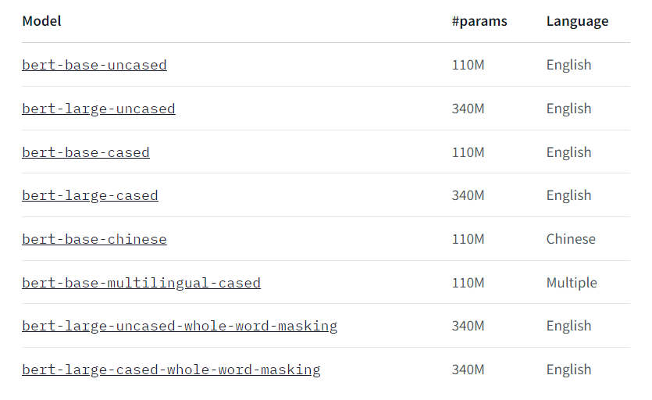
2 NER model change BERT
Base-model issue

Slide 4
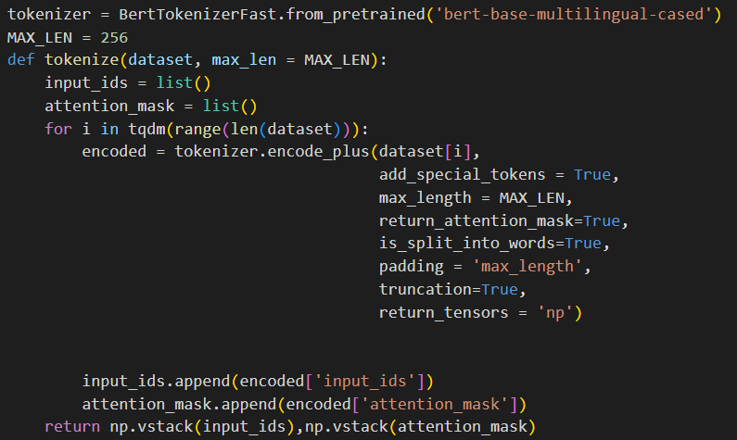
Steps
Tokenize
Build Model

Slide 5
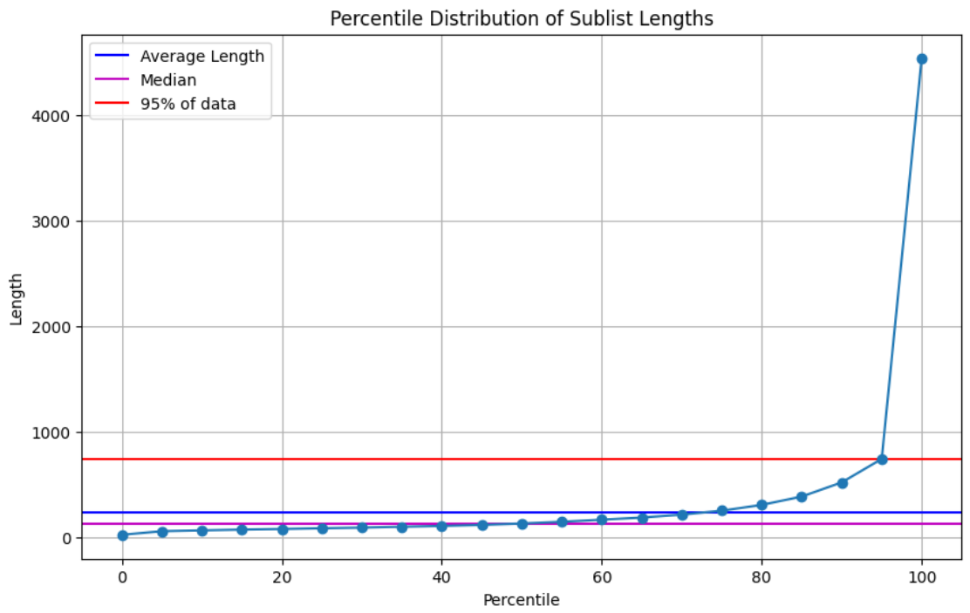

Slide 6
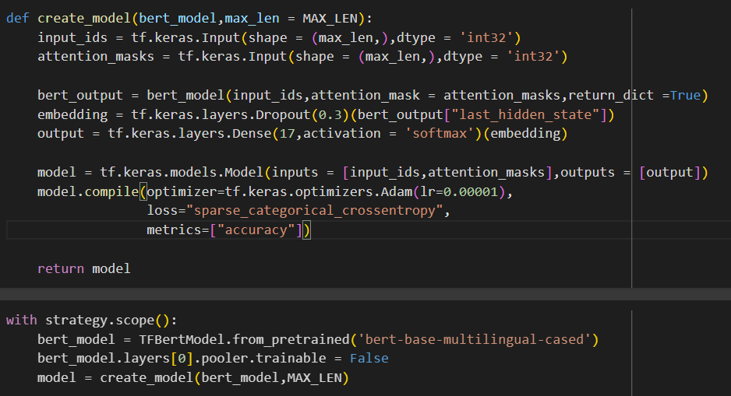
Steps
Tokenize
Build Model

Slide 7
Training
Error:
From NER Transformer
Change the maxlen input for model
Solution
Filter the dataset (length)
How ?
256 length
Percent ?
75%

Slide 8
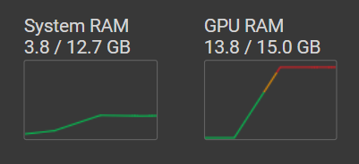
Training runtime
CPU runtime
crash
TPU runtime
ok

Slide 9
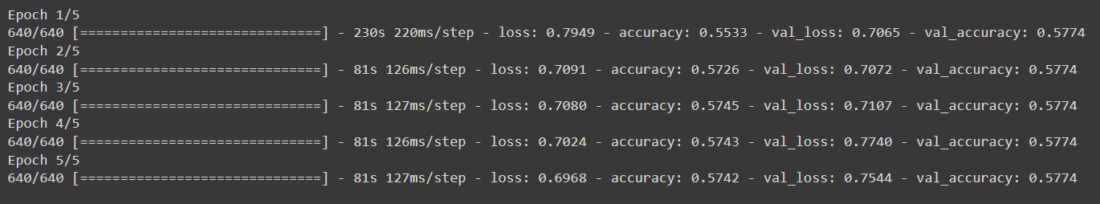
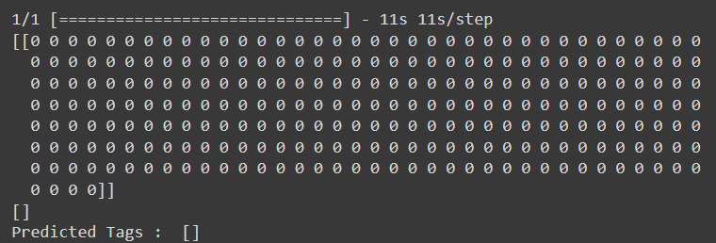
Result

Slide 10
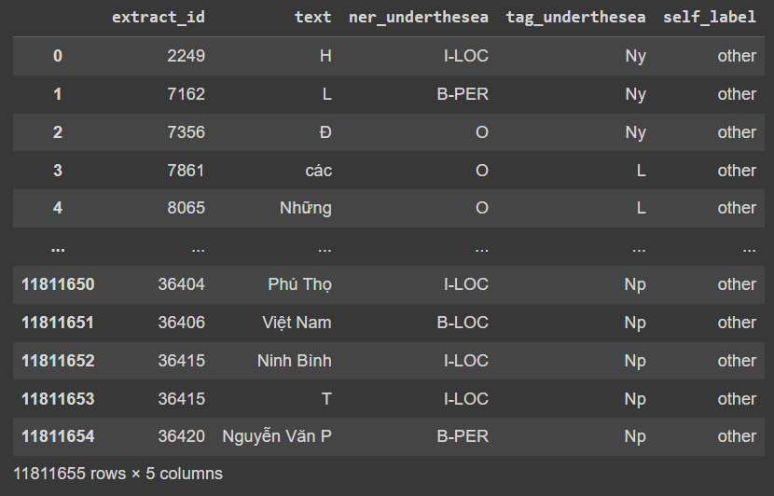
3 Bigquery Data read sequence

Slide 11
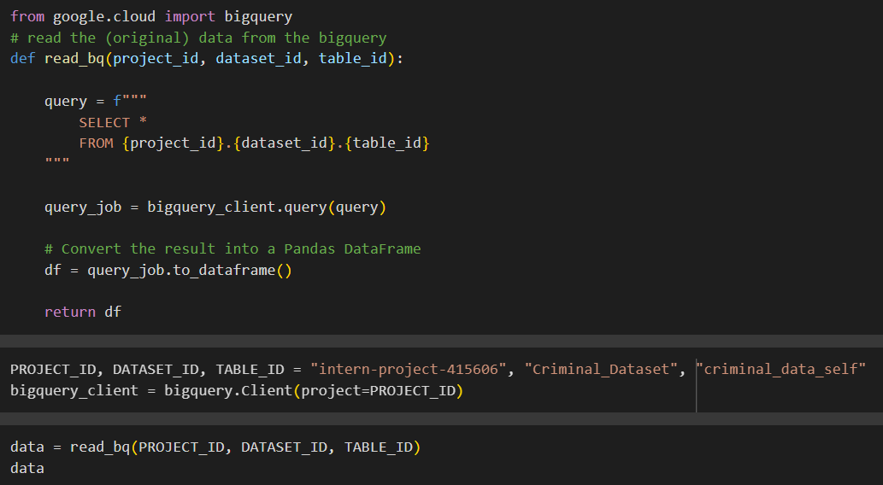

Slide 12
Problem and solution
Problem
Cannot form correct order / sequence of sentence in training
In Bigquery the data are in correct order
Solution
Add a column call index (group by extract_id, sort by index)
New bigquery table (Add new column “sequence”)

Slide 13
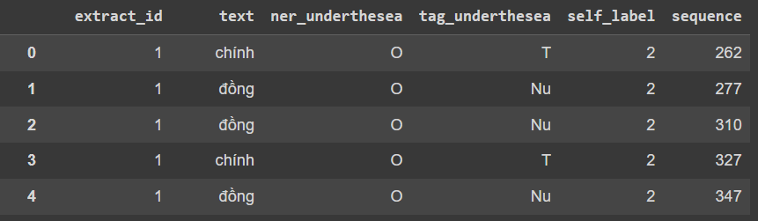
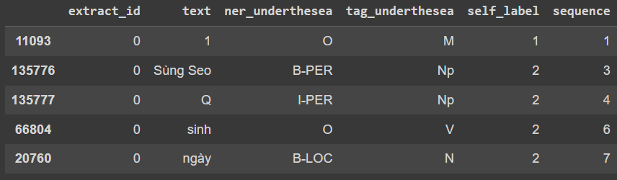
# Sort the DataFrame by the "index" column
dataset = dataset.sort_values(by='sequence')
dataset

Slide 14
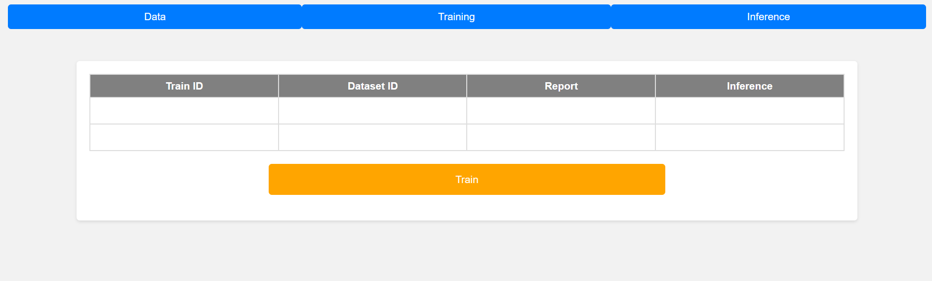
DDD ML web
Web function > DDD

